Slide 1

TWITTER DATABASE
PREPARED BY
KULASEKHAR REDDY NARPALA
INDRAJA REDDY
JALLA MAMATHA
SAI AKASH
AVINASH

Slide 2
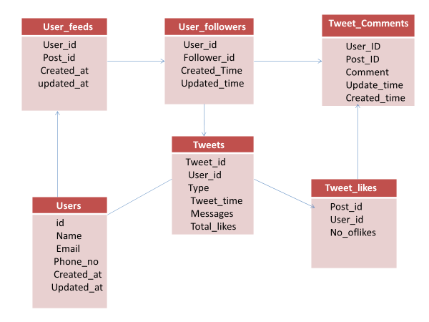
TWITTER SCHEMA

Slide 3
E-R DIAGRAM OF TWITTER

Slide 4
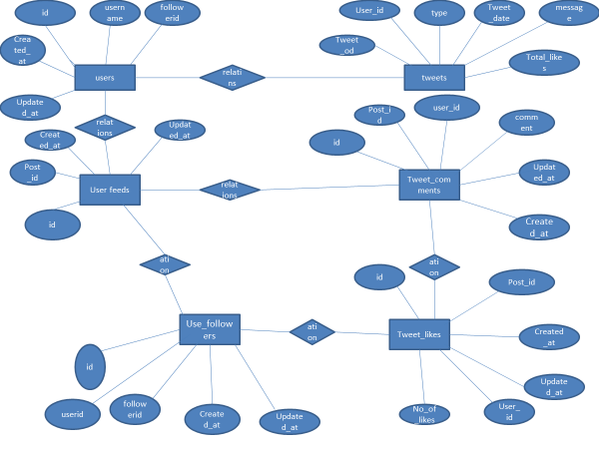

Slide 5
CREATING DATABASE
CREATING DATABASE
COMMNAD
CREATE DATBASE TWITTER1;
USING DATABASE
COMMAND
USE TWITTER1;

Slide 6
CREATING TABLES
CREATING USERS TABLE
CREATING USER_FOLLOWERS TABLE
CREATING TWEETS TABLE
CREATING USERFEEDS TABLE
CREATING COMMENT TABLE
CREATING TWEET_LIKES TABLE

Slide 7
INSERTING DATA
DATA INSERTED SUCCESSFULLY FOR ALL TABLES

Slide 8
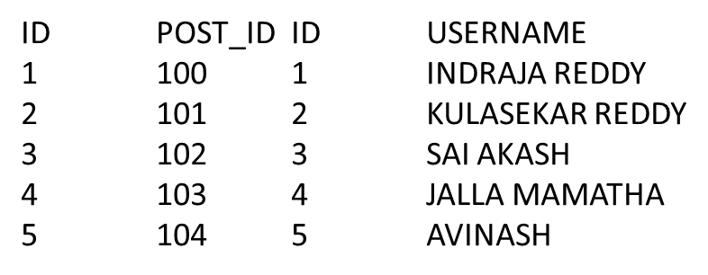
QUERIES
QUERIES FROM INDRAJA
/*1.TO SELECT POST AND USER NAME FROM TWO TABLES USING IMMSER JOIN*/
SELECT UF.ID,UF.POST_ID,U.ID,U.USERNAME
FROM USERFEEDS1 UF INNER JOIN USERS1 U ON UF.ID=U.ID;
OUTPUT

Slide 9
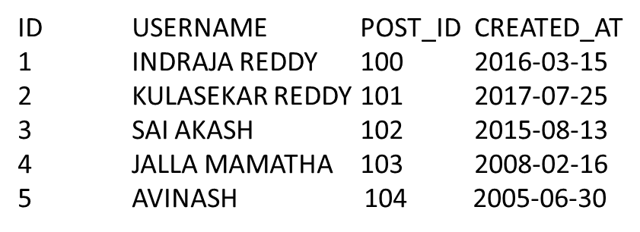
/*2. TO SELECT USERID,POST_ID,USERNAME,CREATED DATE BY USING FULL JOIN*/
SELECT UF.ID,U.USERNAME,UF.POST_ID,UF.CREATED_AT FROM
USERFEEDS1 UF FULL JOIN USERS1 U ON UF.ID = U.ID;
OUTPUT

Slide 10
/*3.TO SELECT TWEET_ID,TYPE,USER NAME USING RIGHT JOIN*/
SELECT T.TWEET_ID,T.TYPE,U.ID,U.USERNAME FROM
TWEETS T RIGHT JOIN USERS1 U ON T.TWEET_ID = U.ID;
TWEET_ID TYPE ID USERNAME
NULL NULL 1 INDRAJA REDDY
NULL NULL 2 KULASEKAR REDDY
NULL NULL 3 SAI AKASH
NULL NULL 4 JALLA MAMATHA
NULL NULL 5 AVINASH

Slide 11
/* 4.TO SELECT USERNAME,ID FROM USERS1 WHERE ID IS GREATER THAN 1,2 */
SELECT U.USERNAME,U.ID FROM USERS1 U WHERE ID>=1
UNION ALL
SELECT U.USERNAME,U.ID FROM USERS1 U WHERE ID>=2;
USERNAME ID
INDRAJA REDDY 1
KULASEKAR REDDY 2
SAI AKASH 3
JALLA MAMATHA 4
AVINASH 5
KULASEKAR REDDY 2
SAI AKASH 3
JALLA MAMATHA 4
AVINASH 5

Slide 12
USING LIKE OPERATOR
/*WRITE A QUERY TO DISPLAY THE POST_ID IF THEY ARE CREATED IN THE YEAR 2016*/
SELECT POST_ID,CREATED_AT FROM USERFEEDS WHERE CREATED_AT LIKE '%16’;
POST_ID CREATED_AT
103 2008-02-16

Slide 13
USING SINGLE ROW FUNCTION
/*WRITE A QUERY TO DISPLAY USERNAME AND EMAIL BY USING SINGLE ROW FUNCTIONS*/
SELECT LOWER(USERNAME),UPPER(EMAIL) FROM USERS1;
USERNAME EMAIL
indraja reddy INDRAJARAMIREDDY@GMAIL.COM
kulasekar reddy KULASEKHARREDDY@GMAIL.COM
sai akash SAIAKASH12@GMAIL.COM
jalla mamatha MAMATHAJALLA@GMAIL.COM
avinash AVINASH123@GMAIL.COM

Slide 14
/* 5.TO SELECT TWEET_ID,TYPE FROM TWEETS USING INTERSECT*/
SELECT TWEET_ID,TYPE FROM TWEETS4
INTERSECT
SELECT TWEET_ID,TYPE FROM TWEETS4;
TWEET_ID TYPE
1 IMAGES
2 LINKS
3 QUOTES
4 RETWEETS
5 COMMENTS

Slide 15
QUERIES FROM KULASEKHAR
SELECT USERNAME,EMAIL
FROM USERS1 U1,USER_FOLLOWERS U2
WHERE U1.ID=U2.ID;
OUTPUT:
USERNAME EMAIL
INDRAJA REDDY indrajaramireddy@gmail.com
KULASEKAR REDDY kulasekharreddy@gmail.com
SAI AKASH saiakash12@gmail.com
JALLA MAMATHA mamathajalla@gmail.com
AVINASH avinash123@gmail.com

Slide 16
SELECT USERNAME
FROM USERS1 U1
FULL JOIN USER_FOLLOWERS U2 ON U1.ID=U2.ID;
OUTPUT:
USERNAME
INDRAJA REDDY
KULASEKAR REDDY
SAI AKASH
JALLA MAMATHA
AVINASH

Slide 17
SELECT USERID,USERNAME
FROM USERS1 U1
RIGHT JOIN USER_FOLLOWERS U2 ON U1.ID=U2.ID
WHERE U1.ID=3 AND U2.ID=3;
OUTPUT:
USERID USERNAME
13 SAI AKASH

Slide 18
QUERIES BY MAMATHA
SELECT T.USER_ID,T.TOTAL_LIKES,F.FOLLOWERID FROM TWEETS4 T JOIN USER_FOLLOWERS F
ON (USER_ID = ID) WHERE FOLLOWERID =15 ORDER BY TWEET_ID DESC;
OUTPUT:
USER_ID TOTAL_LIKES FOLLOWERID
4 3429 15

Slide 19
SELECT T.TWEET_ID,T.TYPE,U.EMAIL
FROM TWEETS4 T,USERS1 U
WHERE T.USER_ID = U.ID;
OUTPUT:
TWEET_ID TYPE EMAIL
1 IMAGES mamathajalla@gmail.com
2 LINKS indrajaramireddy@gmail.com
3 QUOTES kulasekharreddy@gmail.com
4 RETWEETS avinash123@gmail.com
5 COMMENTS saiakash12@gmail.com

Slide 20
SELECT TWEETS4.TWEET_ID,USERS1.USERNAME
FROM USERS1 INNER JOIN TWEETS4 ON USERS1.ID = TWEETS4.USER_ID;
OUTPUT:
TWEET_ID USERNAME
1 JALLA MAMATHA
2 INDRAJA REDDY
3 KULASEKAR REDDY
4 AVINASH
5 SAI AKASH

Slide 21
QUERIES FROM AVINASH
SELECT UF.ID,UF.POST_ID,U.ID,U.USERNAME
FROM USERFEEDS1 UF INNER JOIN USERS1 U ON UF.ID=U.ID;
OUTPUT:
ID POST_ID ID USERNAME
1 100 1 INDRAJA REDDY
2 101 2 KULASEKAR REDDY
3 102 3 SAI AKASH
4 103 4 JALLA MAMATHA
5 104 5 AVINASH

Slide 22
SELECT U.USERNAME,U.ID FROM USERS1 U WHERE ID>=1
UNION ALL
SELECT U.USERNAME,U.ID FROM USERS1 U WHERE ID>=2;
OUTPUT:
USERNAME ID
INDRAJA REDDY 1
KULASEKAR REDDY 2
SAI AKASH 3
JALLA MAMATHA 4
AVINASH 5
KULASEKAR REDDY 2
SAI AKASH 3
JALLA MAMATHA 4
AVINASH 5

Slide 23
SELECT TWEET_ID,TYPE FROM TWEETS4
INTERSECT
SELECT TWEET_ID,TYPE FROM TWEETS4;
OUTPUT:
TWEET_ID TYPE
1 IMAGES
2 LINKS
3 QUOTES
4 RETWEETS
5 COMMENTS

Slide 24
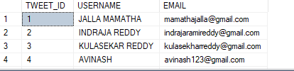
QUERIES FROM AKASH
//TO SELECT TWEET ID ,USERNAME, EMAIL ,BY USING FULL JOIN// SELECT T.TWEET_ID,U.USERNAME ,U.EMAIL FROM TWEETS T FULL JOIN USERS1 U ON T.USER_ID= U.ID;
OUTPUT:

Slide 25
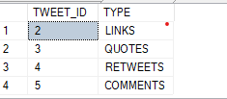
//WAQ TO SELECT TWEET ID AND TYPE EXCEPT TWEET_ID IS 1 // SELECT TWEET_ID,TYPE FROM TWEETS EXCEPT SELECT TWEET_ID,TYPE FROM TWEETS WHERE TWEET_ID=1;
OUTPUT:

Slide 26
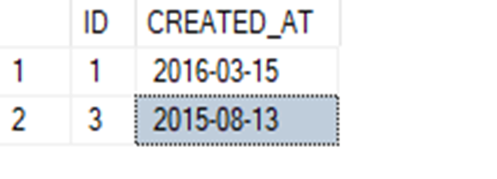
//WAQ TO SELECT USER FEEDID,CREATE DATE, WHERE NO OF LIKES GREATER THAN 300//
SELECT UF.ID,UF.CREATED_AT
FROM USERFEEDS1 UF
WHERE UF.ID IN(SELECT TL.ID FROM TWEET_LIKES TL WHERE NO_OF_LIKES>=300);
OUTPUT:

Slide 27
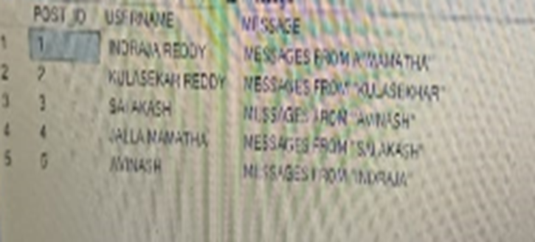
//query to find the postid ,username,message// SELECT TL.POST_ID,U.USERNAME,T.MESSAGE FROM TWEET_LIKES ,USERFEEDS1 ,USERS1 WHERE TL.ID=U.ID AND U.ID=T.TWEET_ID;
OUTPUT:

Slide 28
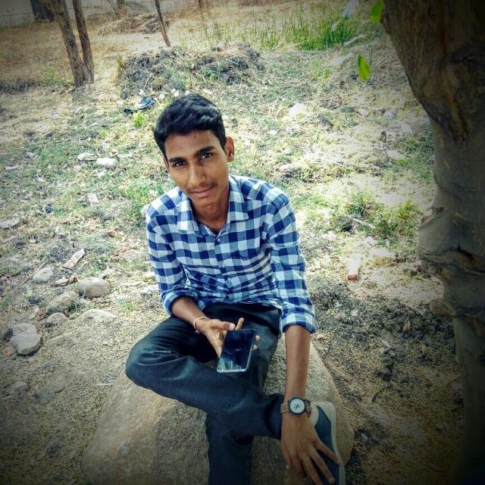
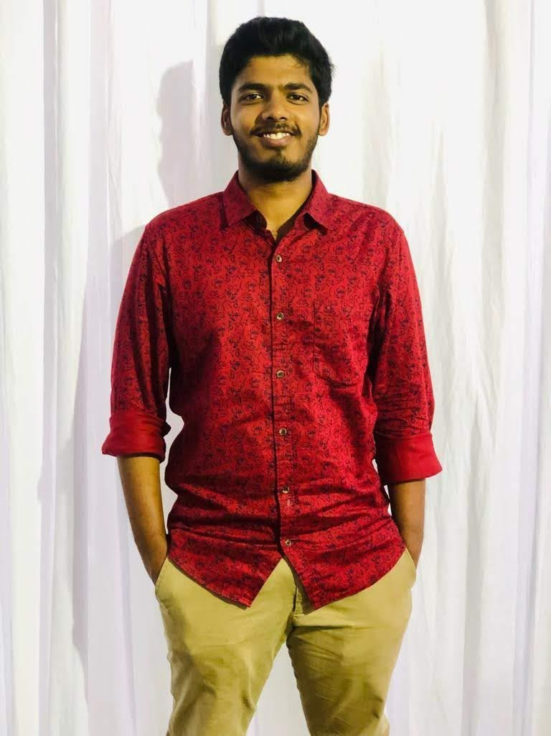
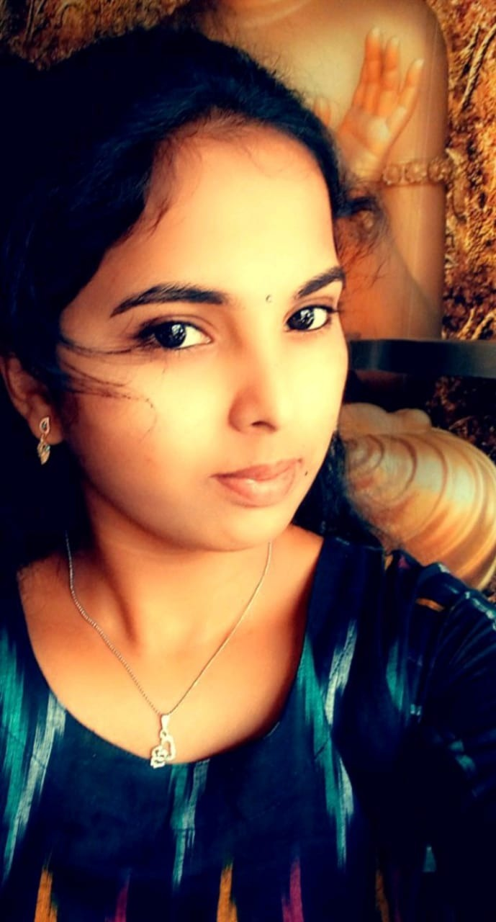
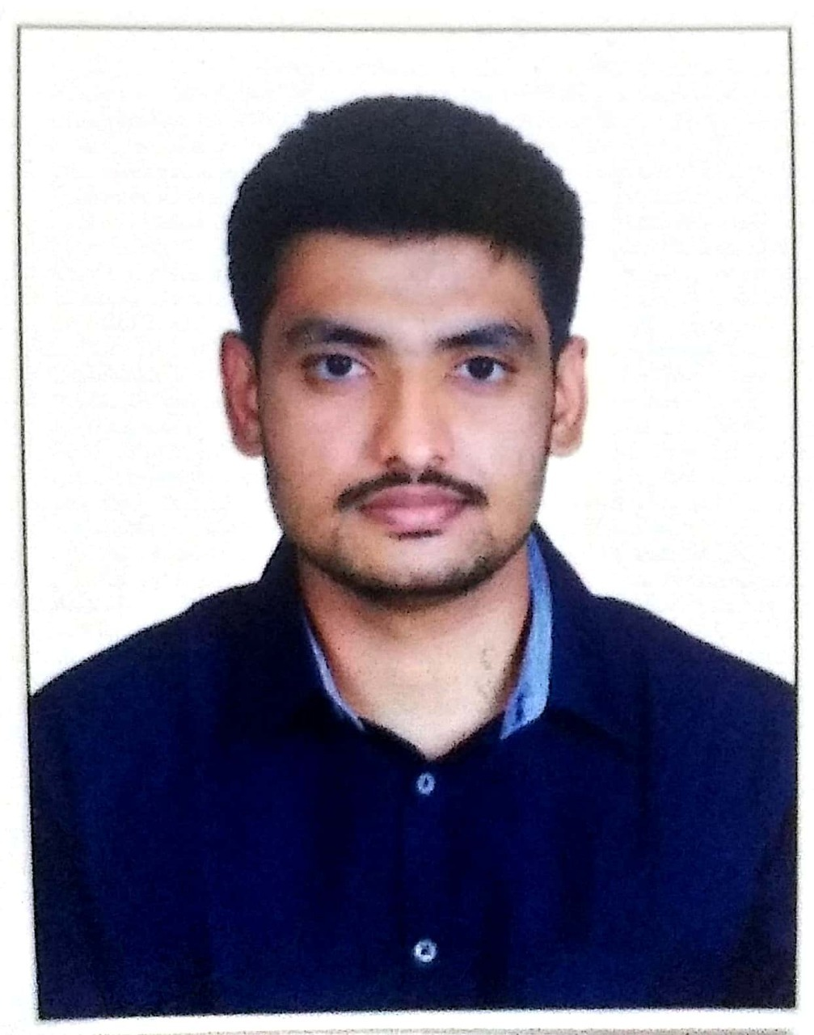
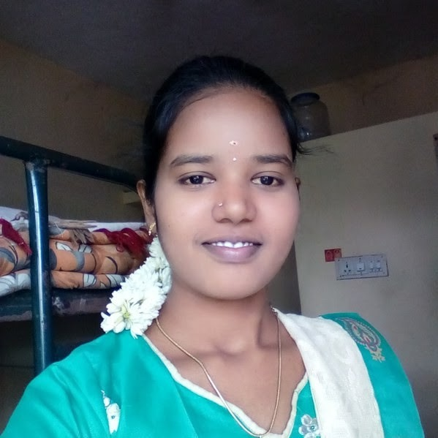
KULASEKHAR REDDY
ASSOCIATE ENG. VIRTUSA
SAI AKASH
ASSOCIATE ENG.
VIRTUSA
INDRAJA REDDY
ASSOCIATE ENG.
VIRTUSA
A
V
I
N
A
S
H
ASSOCIATE ENG.
VIRTUSA
M
A
M
A
T
H
A
ASSOCIATE ENG.
VIRTUSA
OUR TEAM

Slide 29
THANK YOU

